Slide 1
Using data to tell stories
Jill Castellano and Brian Duggan
Reno training, 8.23.17

Slide 2
“In God we trust. All others must bring data.”
– W. Edwards Deming, statistician, professor, author, lecturer, and consultant.
Notes:
Whether you like it or not, data is the future of journalism. It’s everywhere. It’s out responsibility to understand it, and to understand its limits.

Slide 3
Data journalism in seven steps
STEP ONE: Save the raw copy of the file. Do not use.
STEP TWO: Start a document to write down the steps in your data analysis
STEP THREE: Check the data for basic errors. Answer any lingering questions.
Always ask for a “data dictionary” or “record layout”
STEP FOUR: “Clean” the data
The data should be square (no blank entries)
Every column represents a single concept
No unnecessary spaces, commas or other formatting issues
STEP FIVE: Analyze the data. Find the story. The data itself is not the story.
STEP SIX: Report on what you see. Get to the bottom of it.
STEP SEVEN: Visualize the data with maps, charts, etc.
Everyone’s a data journalist!

Slide 4
Why is data journalism important?
It’s a way to fact check statements on trends to find out what’s really going on
You can find stories you otherwise wouldn’t be able to
There’s more and more data out there that sources will point you to so you should know how to use it
You will become a valuable asset to any newsroom
Notes:
Why data journalism?
Uncover basic information (simple lookups)
Test government procedures, regulations and officials’ promises
Get their numbers and check if what they’re doing is what they say they’re doing
Enterprise reporting: do stories that no one else is doing
New ways to tell stories via visuals and more
Being able to use a program isn’t the same as being able to use a program for journalism
Attribution vs. Verification
Most news is attribution journalism (call, they told us something, we quoted them)
Data lets you move to verification (make people prove for us what they say)
Documents are good for that too
Not verifying is why people don’t trust the media
You can then say: “they cannot immediately provide data to verify this statement”
Example: potholes mapping tool

Slide 5
Getting a data set of mind
Always think: is there a document or database to back this up?
Data is one source, not the source
Remember: data is never “perfect”
CAR doesn’t replace solid street reporting skills
Let’s look through different examples of data journalism and what they accomplish.
Notes:
Best question to your source: tell me how it works!
Write down anything that sounds like a database!

Slide 6
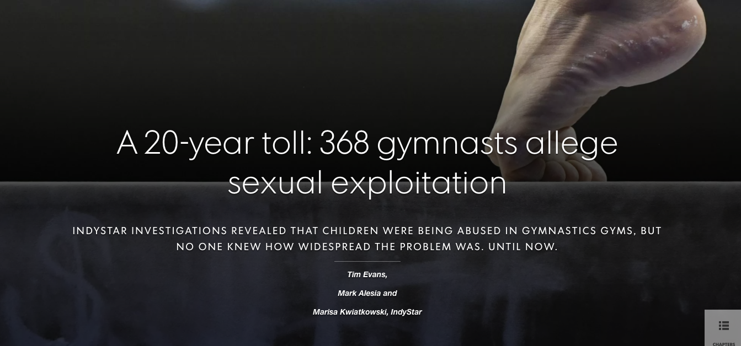
Investigate the scope of a problem
Notes:
To tally the number of potential victims, IndyStar reporters scoured thousands of pages of public records and two decades of news stories.
Reporters also interviewed more than 100 people, including gym owners, athletes, coaches, police officers, prosecutors and child advocates, as well as survivors who came forward after the newspaper’s original investigation in August. More than 80 others declined to talk publicly.

Slide 7

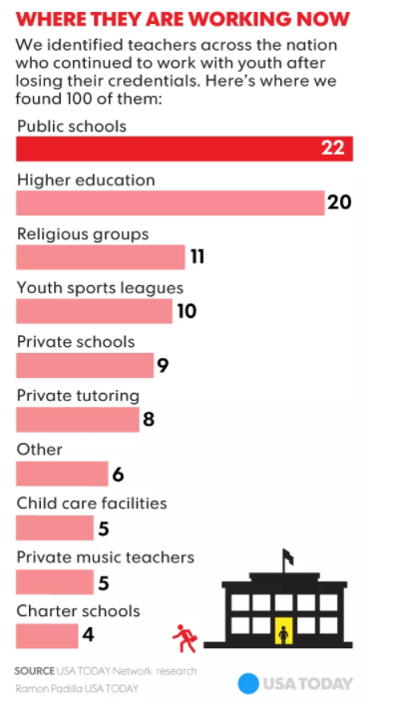
Combine data sources together to learn something new
Notes:
In the most comprehensive national review of teacher discipline to date, USA TODAY examined educator misconduct and licensure databases from every state, reviewed thousands of pages of court filings and employment records and surveyed state education officials to determine how teachers who engage in misconduct remain in the education system.

Slide 8
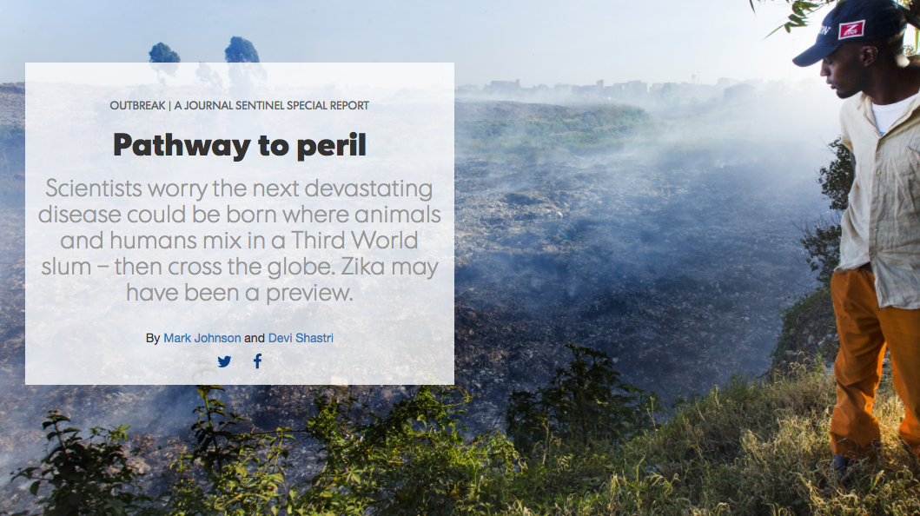
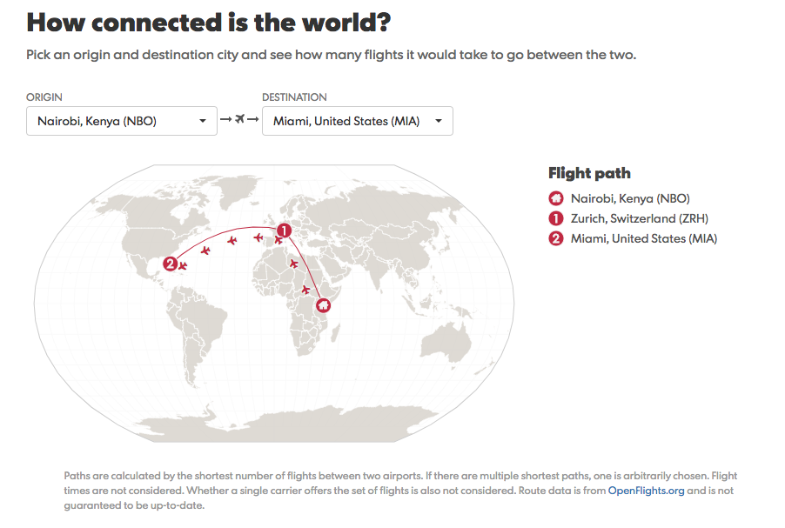
Explain why the problem matters
Notes:
Milwaukee-Journal Sentinel

Slide 9
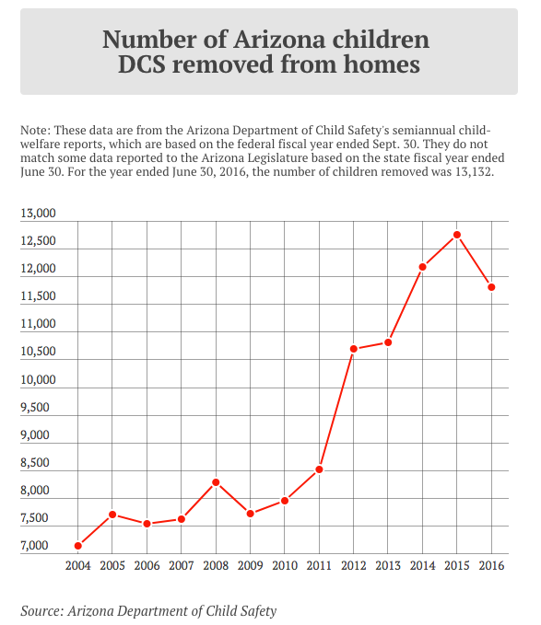
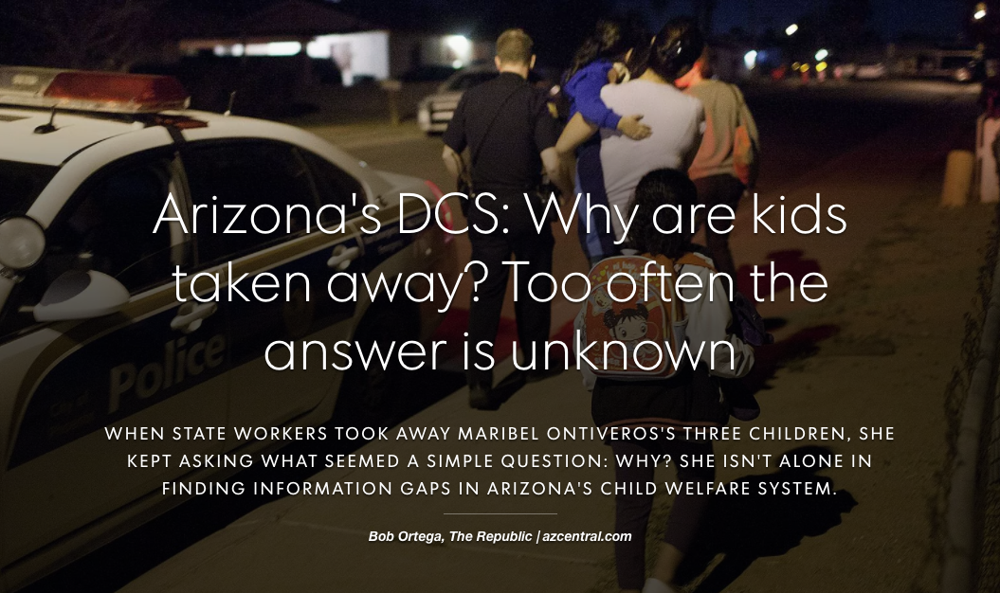
Use data as the starting point
Notes:
Arizona has seen easily the steepest increase of any state in how many kids it removes from their families. Since 2005, as the number of children in the foster-care system declined in most states, it climbed in Arizona, nearly tripling to peak at more than 19,000 children at the end of February. That surge overwhelmed the Department of Economic Security’s Child Protective Services division. By late 2013, CPS faced a still-rising backlog of more than 14,000 inactive, uninvestigated reports of child abuse or neglect. There were too few foster families, too few spaces in group homes. Children waiting to be placed were sleeping in caseworkers' offices and cars.
This story is part of an ongoing investigation of child-welfare issues in Arizona. In 2016, when the number of children removed from their families peaked at over 18,000, the Arizona Community Foundation gave The Arizona Republic and azcentral.com a three-year grant to support in-depth research on the topic. As part of that effort, reporter Bob Ortega and our other experts investigate the reasons behind the surge in foster children and the systems meant to support and protect them. Through our reporting and editorial pages, we seek solutions to those problems.

Slide 10

Investigate someone’s statements
Notes:
Building your own dataset! Combination of data and records.
Trump has never disclosed a complete, unit-by-unit inventory of his companies' real estate holdings or sales, nor is he required to do so by federal law. Trump says he's separated himself from his businesses, but the trust set up in January is run by his sons. Trump is the only beneficiary and can withdraw funds at any time.
USA TODAY spent four months cataloging every property Trump's companies own across the country. Reporters found that Trump’s companies are sitting on at least $250 million of individual properties in the USA alone. Property records show Trump’s trust and his companies own at least 422 luxury condos and penthouses from New York City to Las Vegas, 12 mansion lots on bluffs overlooking his golf course on the Pacific Ocean and dozens more smaller pieces of real estate. The properties range in value from about $200,000 to $35 million each.

Slide 11
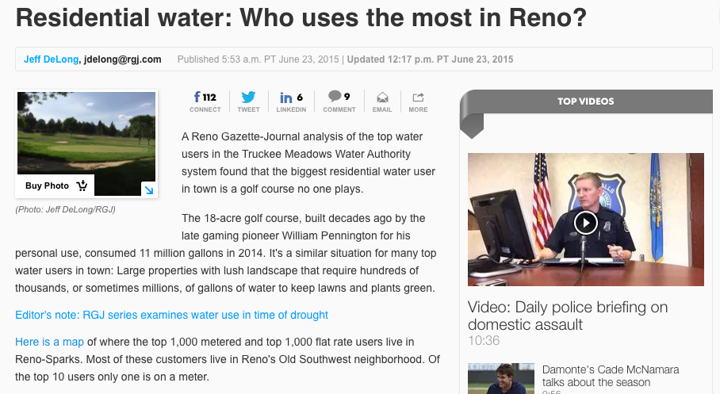
The water users project
Notes:
Brian Duggan describes in detail an example from Reno!

Slide 12
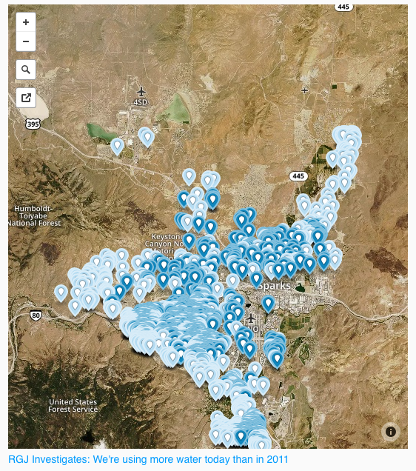
The water users project
Notes:
Brian Duggan describes in detail an example from Reno!

Slide 13
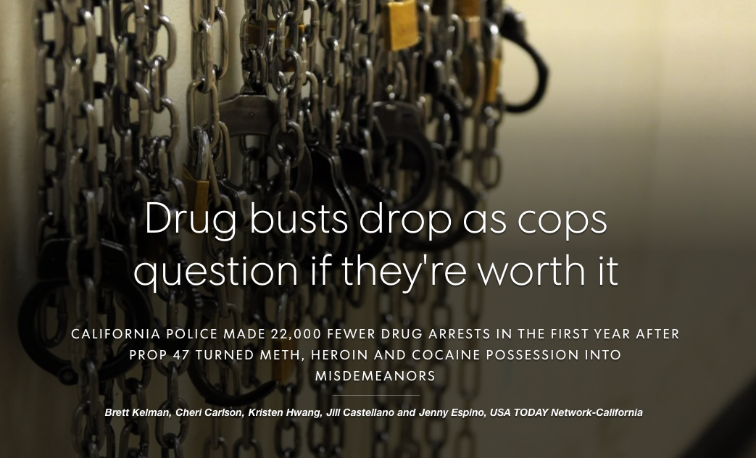
The prop 47 project
Notes:
-Looked at AG’s office’s data, all arrests and reported crimes in California for the last 10 years
-Using Excel, made lots and lots of pivot tables, grouping the data to look at each year’s data at a county-by-county level
-Isolated the data to the crimes that were directly affected by Prop 47: drugs and thefts/burgalries
-Calculated the statistical variation in the data before Prop 47 to properly compare it to the year of data after Prop 47 (consulted with criminologists and PPIC)
-Statistically, yes, drug arrests are WAY down for every kind of drug. Prop 47 just reclassified these drug crimes from felonies to misdemeanors, so that alone wouldn’t change the number of arrests. Through interviews we found that cops didn’t care enough to keep arresting people when they’d be back out on the streets again in a matter of days.

Slide 14
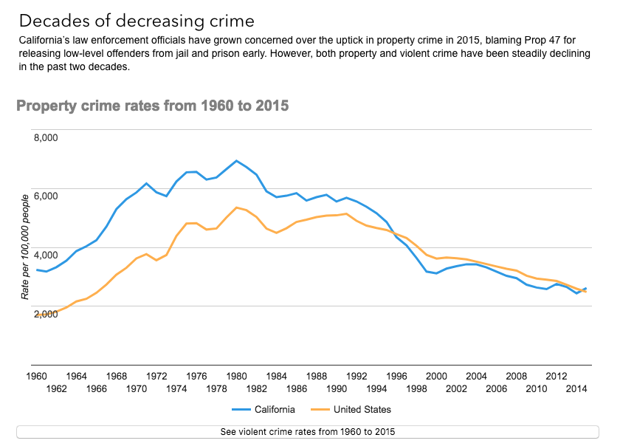
The prop 47 project
Notes:
-Statistically, no, despite what cops say, we have no clear evidence to show that theft/burglary actually went up after Prop 47. There was a slight increase but it’s within the normal variation of crime. Meanwhile, cops are saying that property crime in SKYROCKETING.

Slide 15
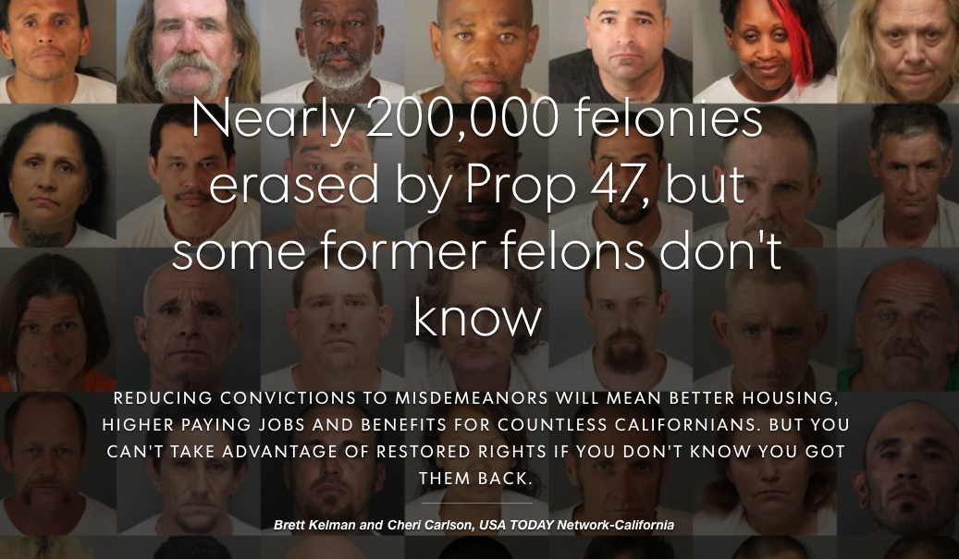
The prop 47 project
Notes:
-First estimate ever of this big number of total felonies erased under Prop 47 – before all we had was the number of people let out of jail early. This includes retroactive felonies being erased too.
-We filed records requests with nearly every California county for Prop 47 records. 21 counties provided reliable data on how many Prop 47 petitions had been filed and granted since the law took effect. More than 70 percent of the state population lives in the responsive counties.
-We calculated an average passage rate for Prop 47 petitions – about 71 percent. A separate total kept by the Judicial Council of California counted all petitions filed for budgetary reasons but had no idea how many of those petitions were approved. The council had tallied 279,235 petitions as of September. If 71 percent of those were approved, then an estimated 198,256 felony convictions were reduced statewide.
-We consulted with an expert criminologist who said this method was usable, as long as we were clear about its limitations.
-However, we wanted an estimate for the number of people affected by Prop 47. It was still unclear if repeat offenders who filed multiple petitions amounted to a large portion of the statewide total. To measure, journalists reviewed handwritten judge’s notes of more than 13,000 Prop 47 cases from Riverside County, which revealed that most defendants only filed one petition for a single felony. If the rest of California follows the same patterns of Riverside, the 198,000 convictions erased across the state represent about 155,000 people.

Slide 16
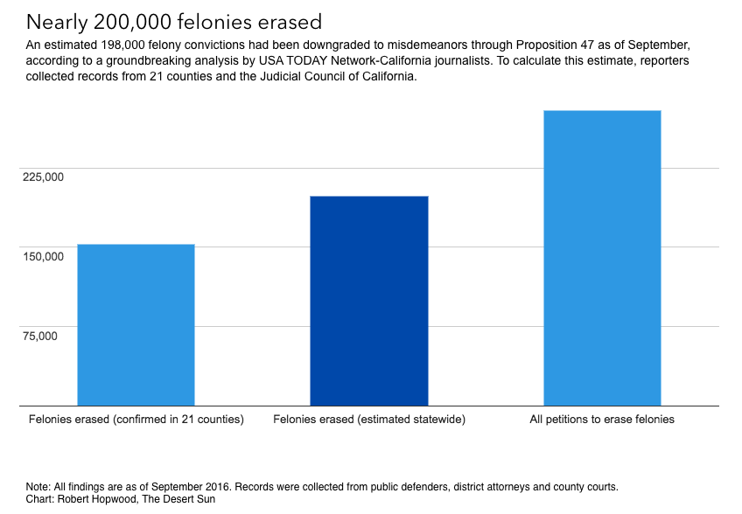
The prop 47 project

Slide 17
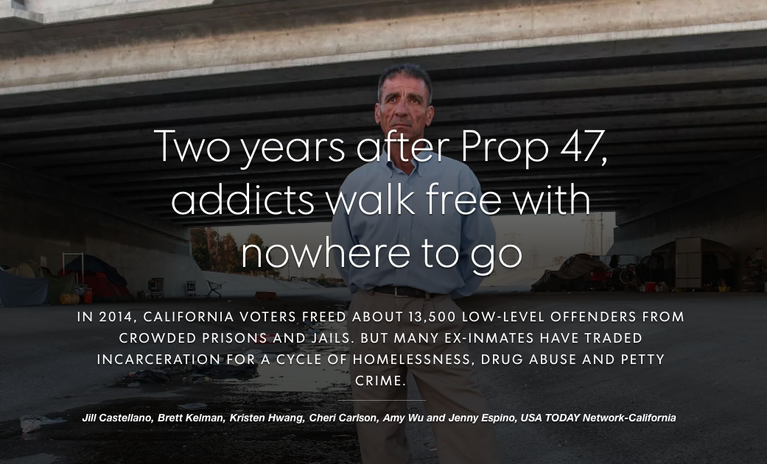
The prop 47 project
Notes:
Our big story actually had very little to do with the numbers

Slide 18
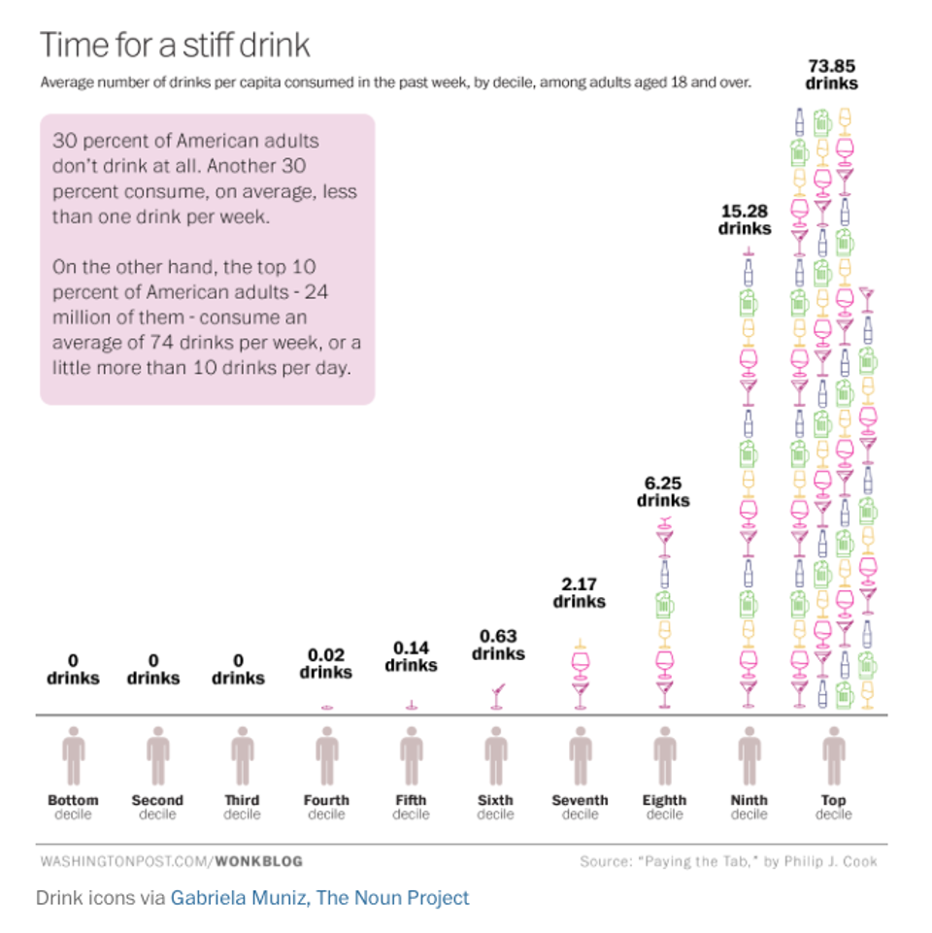
EXAMPLES OF bad DATA JOURNALISM
Notes:
The chart, reproduced below breaks down the distribution of drinkers into deciles, and ends with the startling conclusion that 24 million American adults—10 percent of the adult population over 18—consume a staggering 74 drinks a week.
The source for this figure is “Paying the Tab,” by Phillip J. Cook, which was published in 2007. If we look at the section where he arrives at this calculation, and go to the footnote, we find that he used data from 2001-2002 from NESARC, the National Institute on Alcohol Abuse and Alcoholism, which had a representative sample of 43,093 adults over the age of 18. But following this footnote, we find that Cook corrected these data for under-reporting by multiplying the number of drinks each respondent claimed they had drunk by 1.97 in order to comport with the previous year’s sales data for alcohol in the US. Why? It turns out that alcohol sales in the US in 2000 were double what NESARC’s respondents—a nationally representative sample, remember—claimed to have drunk.

Slide 19
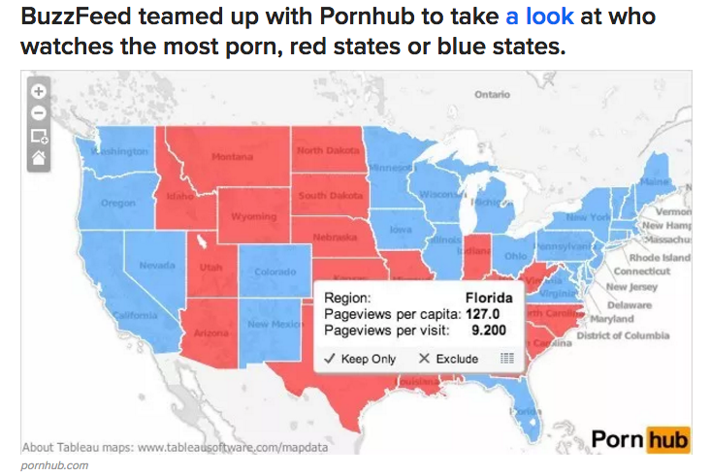
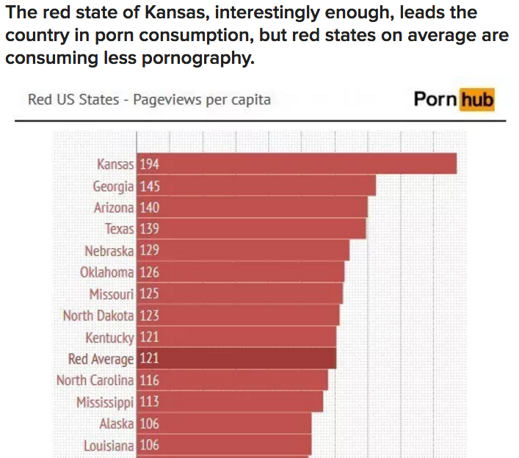
Examples of bad data journalism
Notes:
https://www.buzzfeed.com/ryanhatesthis/who-watches-more-porn-republicans-or-democrats?utm_term=.pxlbKV3lx#.mlRP947VX
Coded states red/blue depending on 2012 presidential vote (even though presidential politics are different from state politics)
Coded IP addresses of visiting computers with likely originating state and divided total page views by population (though people can change where they show up)
Found that Republican Kansas leads the U.S. (Placement of location in middle of U.S. when no state match found, which is Kansas!)
Major problem: you can’t tell whether Democrats and Republicans themselves unless you poll them (we only know about states in this case; very binary)
Pornhub doesn’t represent all sources!
No discussion of other alternative explanations

Slide 20
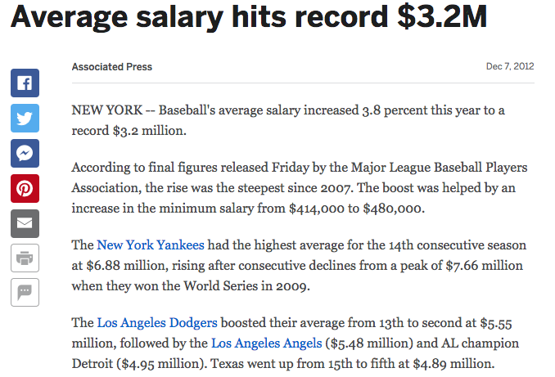
Examples of bad data journalism
Notes:
Associated Press reported this whole story with average salaries, when they should be looking at medians. Same thing with median home prices. More accurate because large numbers at the very top skew the data.

Slide 21

EXAMPLES OF bad DATA JOURNALISM

Slide 22
How to avoid bad data journalism
Don’t jump to conclusions
Investigate the data before you report on it
Clearly explain the data to your audience
Don’t republish conclusions formed by somebody else
American Press Institute
Notes:
Quick tips from the american press institute

Slide 23
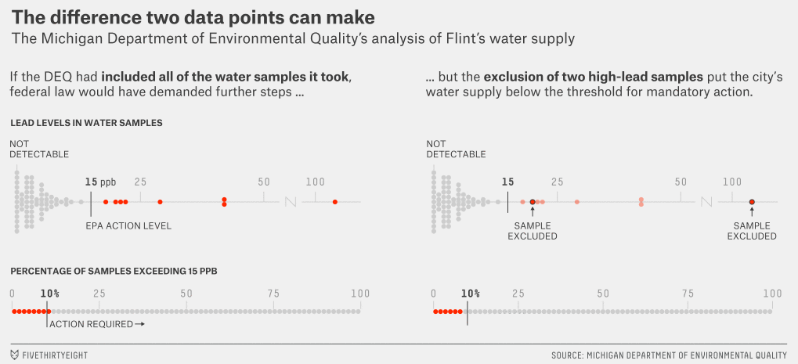
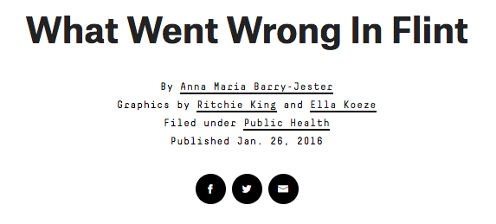
How to handle bad data
Notes:
FiveThirtyEight story:
They took few samples and took them from the wrong places, using a protocol known to miss important sources of lead, which some say didn’t comply with a 25-year-old law meant to prevent lead exposure in residential water.
They threw out two samples whose inclusion would have put more than 10 percent of the tests above what’s known as the “actionable level” of lead, 15 parts per billion. Had the DEQ not done so, the city would have been required to warn residents that there was a problem with lead in the water back in the summer of 2015, or possibly earlier.

Slide 24
tools for analyzing data
Excel, google sheet (simple database)
↓
Access, SQL, MySQL (relational database)
↓
Python, R, Ruby (coding language)

Slide 25
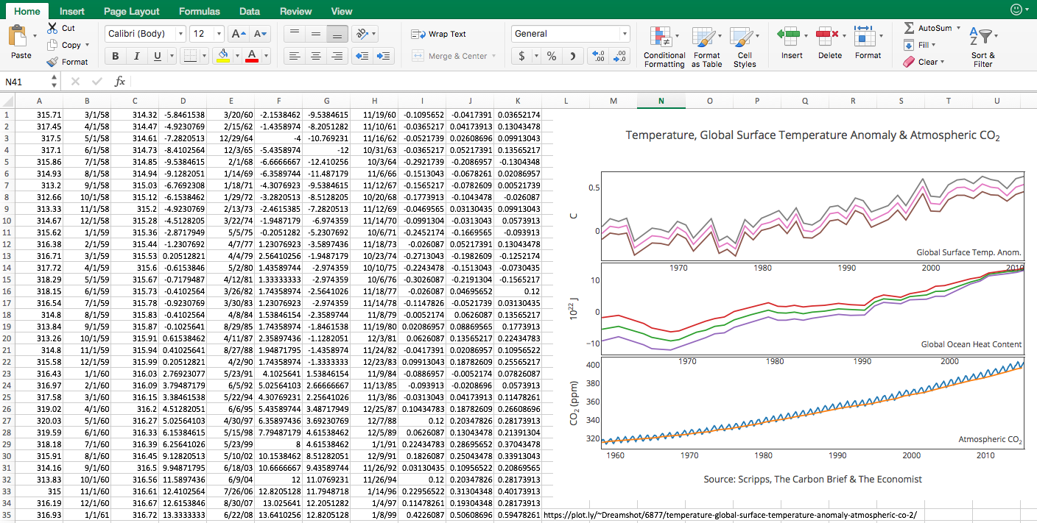
excel
Notes:
Can do great work to clean data in Excel. Also, the power of the pivot table.

Slide 26
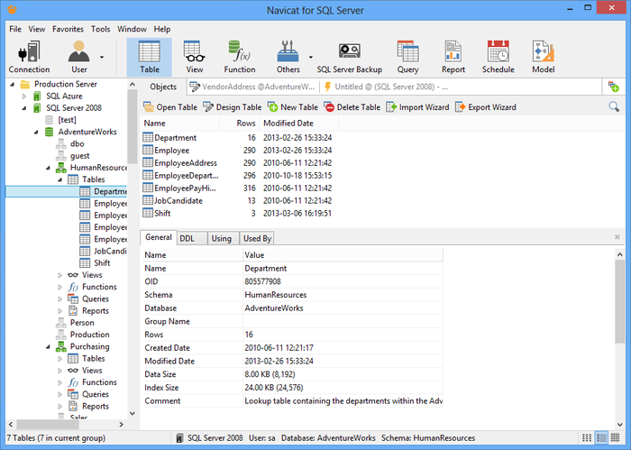
sql

Slide 27
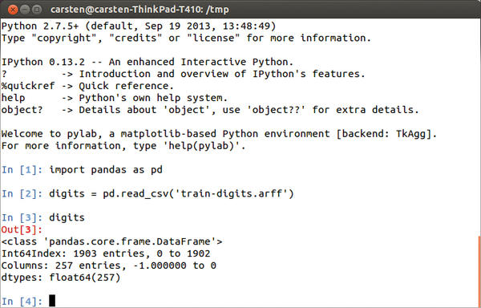
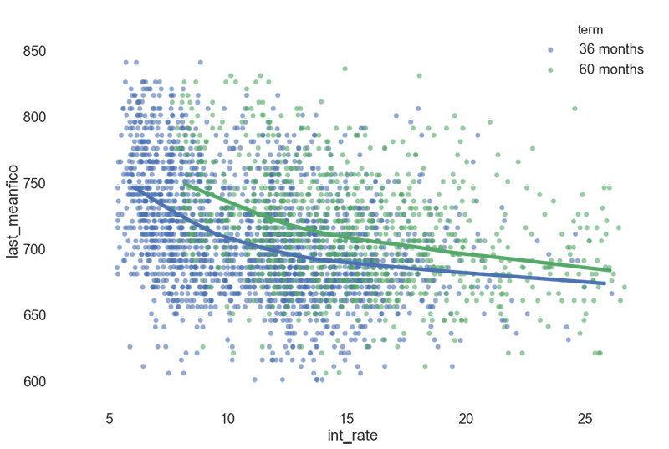
python

Slide 28
Tools for analyzing geocoded data
Google Fusion tables, Datawrapper, CartoDB (little design control)
↓
Tableau (more control)
↓
QGIS, ArcGIS (most control)

Slide 29
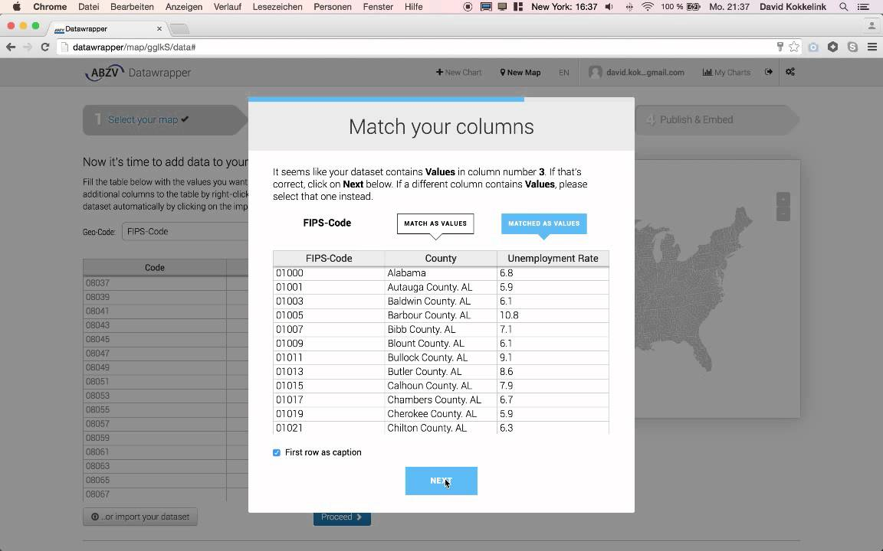
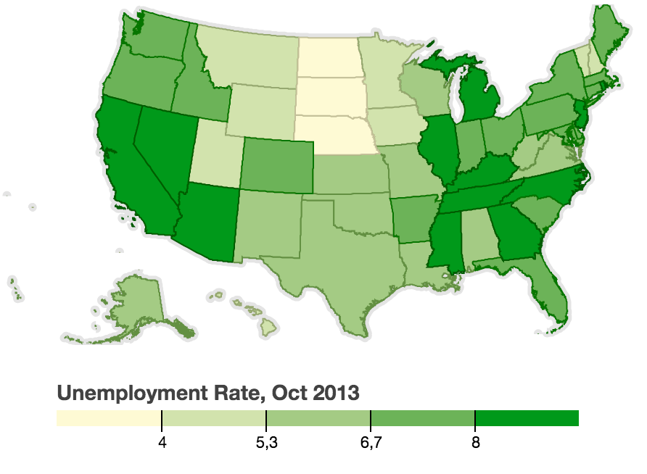
datawrapper

Slide 30
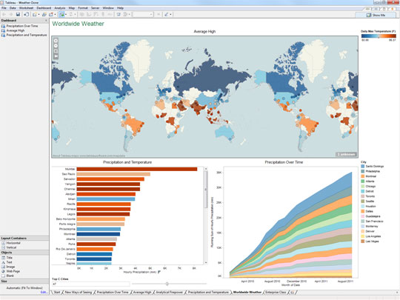
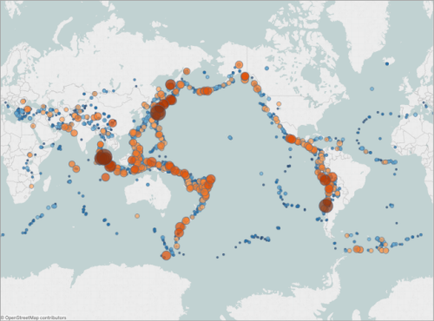
tableau

Slide 31
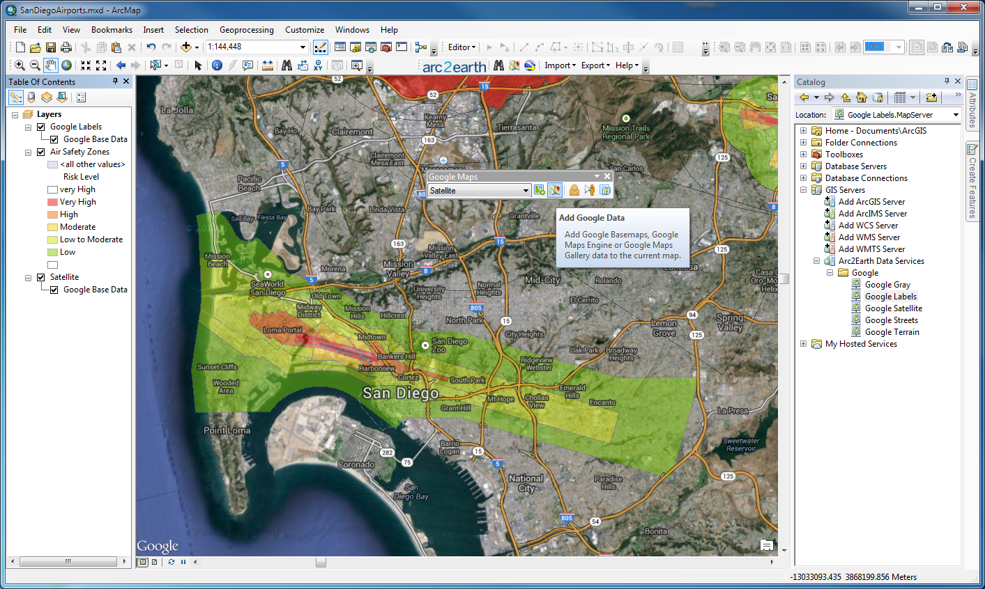
arcgis

Slide 32
Tools for scraping webpages
Google sheet (one formula)
↓
Import.io, OutWit Hub, Power BI (plug-ins and web apps)
↓
Python, Ruby, R (coding)

Slide 33
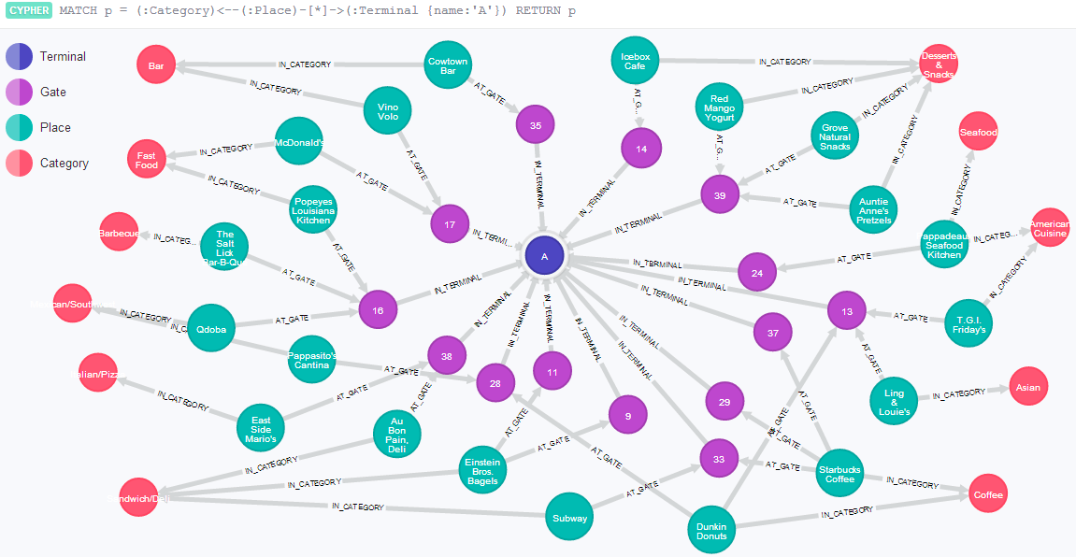
Other data tools: graph databases
Neo4j and Cypher
Notes:
“Data Journalism Accelerator Program” to help journalists with their work; free for journalists

Slide 34
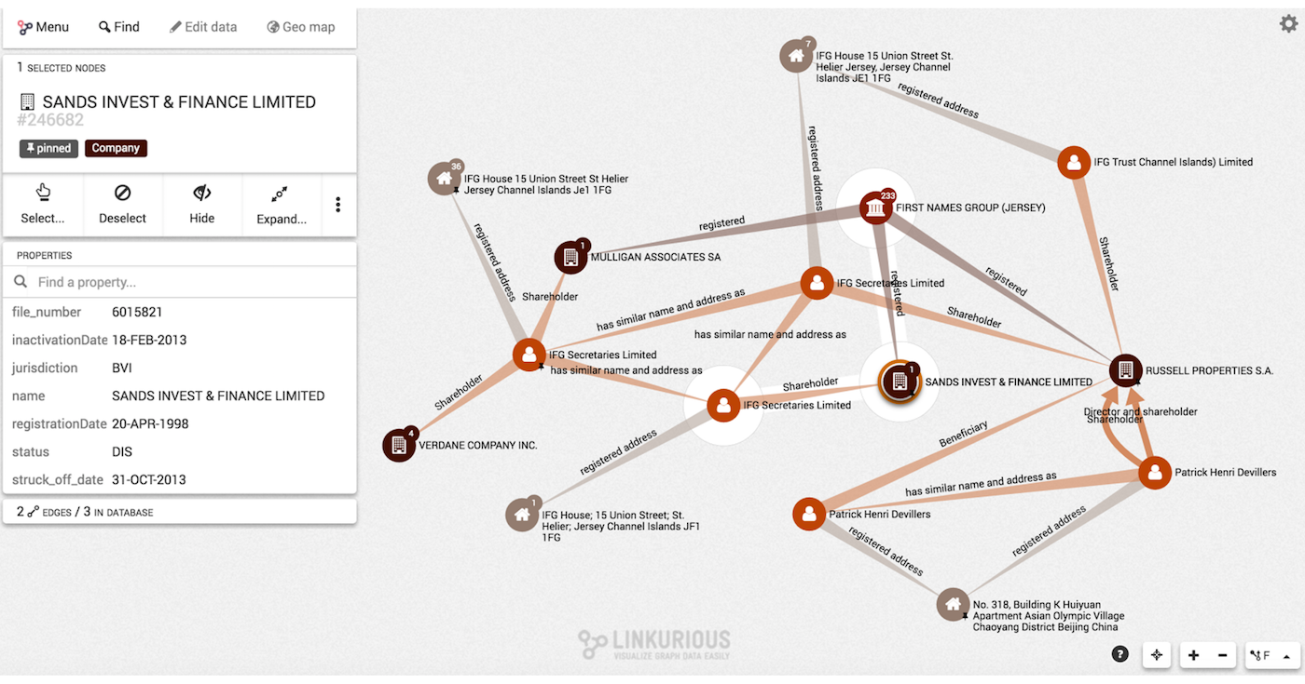
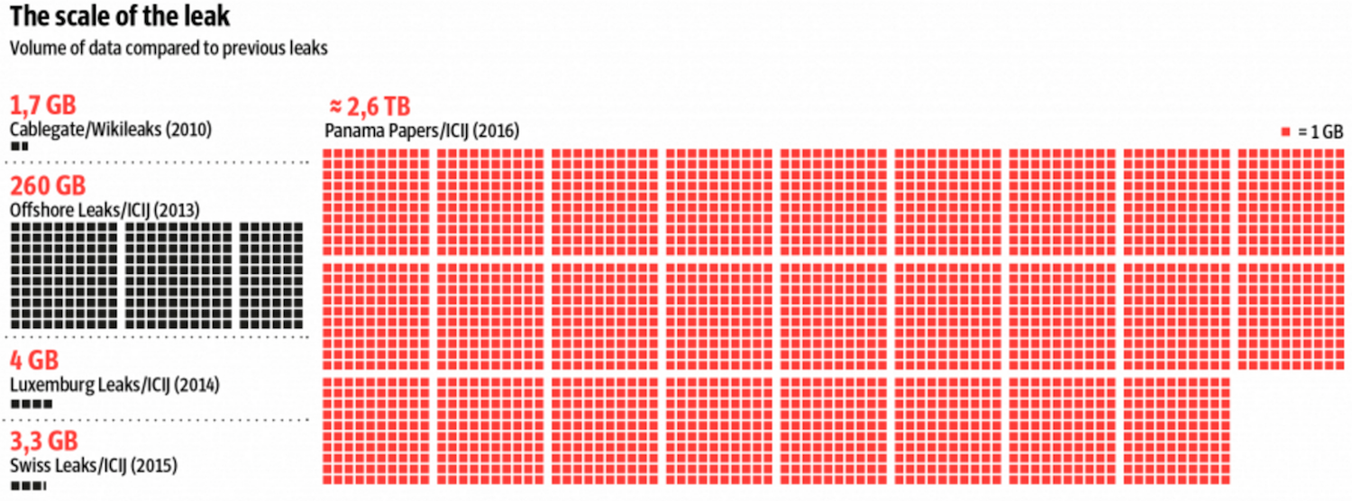
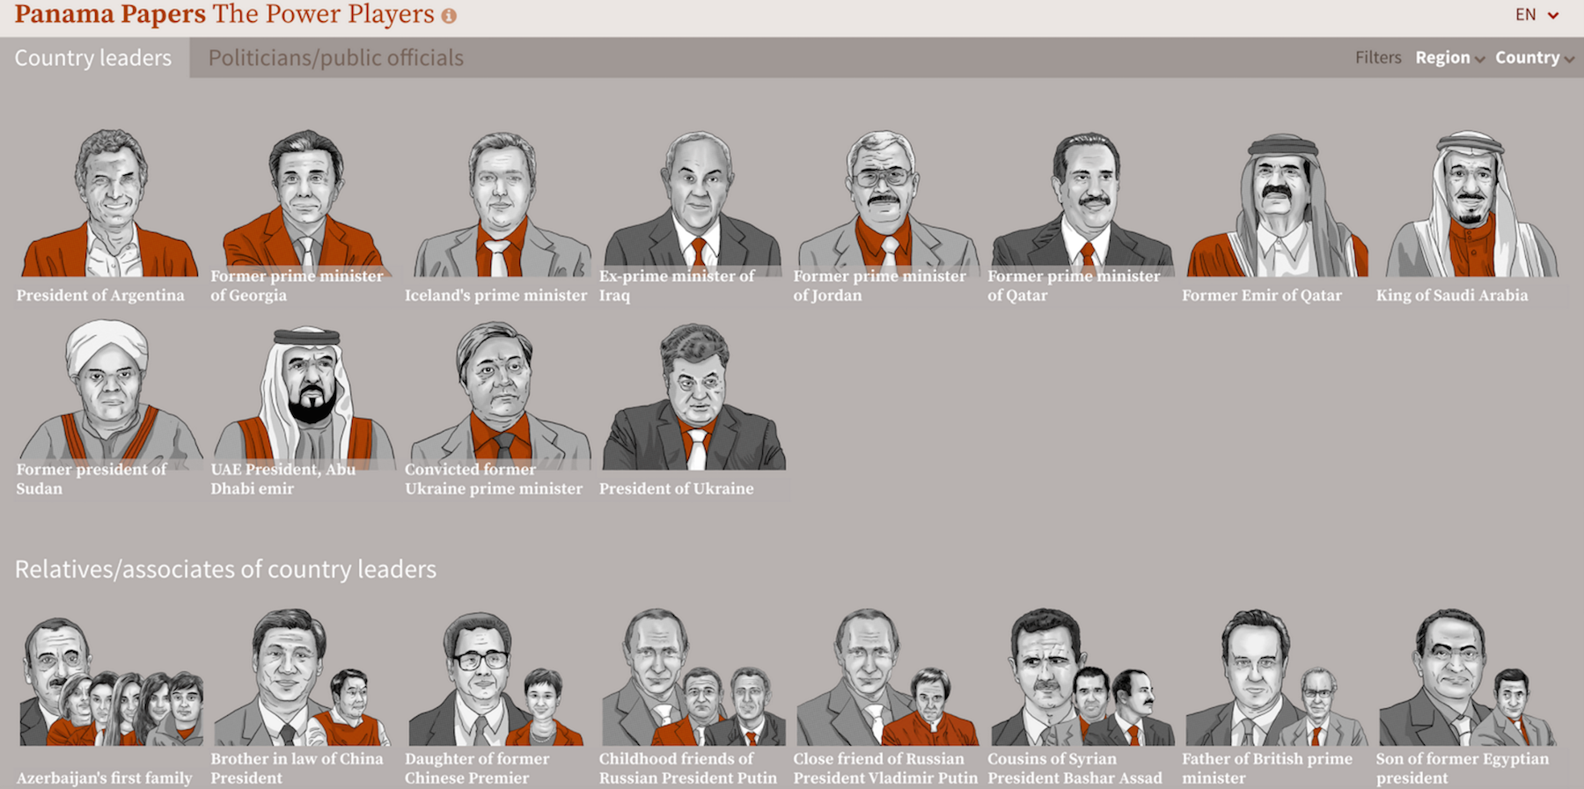
Notes:
Panama Papers used Neo4j

